Slide 1
Applied Studies - Design in Metal
Year 8

Slide 2
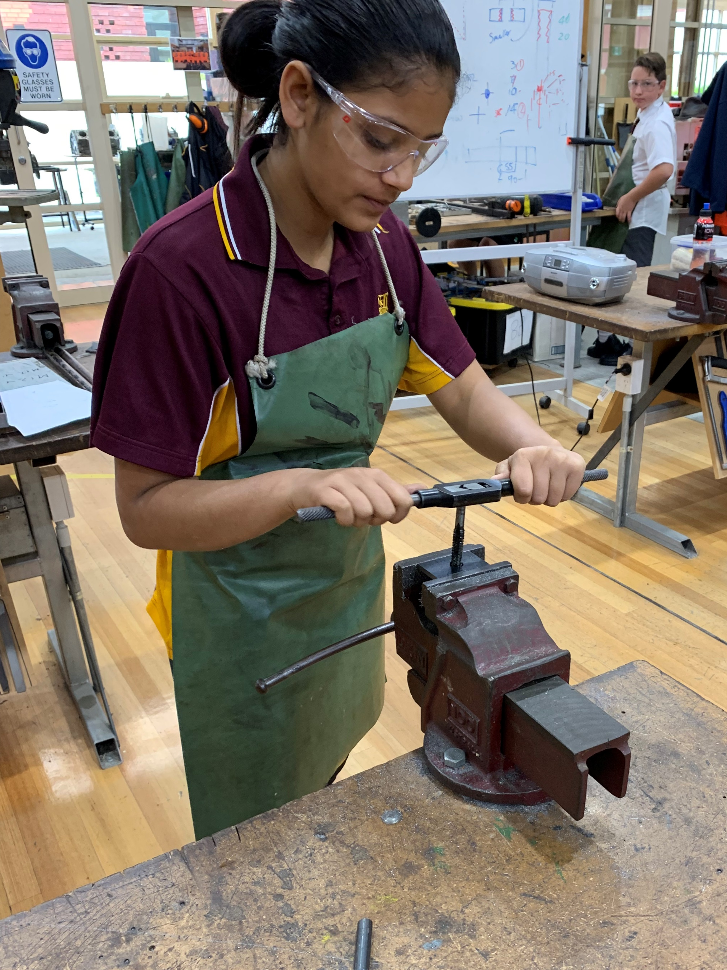
Design in Metal
1 year course
Learn to use tools and machines for making metal projects
Theory and research projects
Focus on wearing Personal Protective Equipment (PPE) and Safety

Slide 3
Find out more…
Please feel free to contact Mrs Selina Kinne, Head of Technology and Applied Studies, at skinne@dominic.tas.edu.au

